Slide 1
Lecture 18 virtual memory
Computer Organization and Architecture

Slide 2
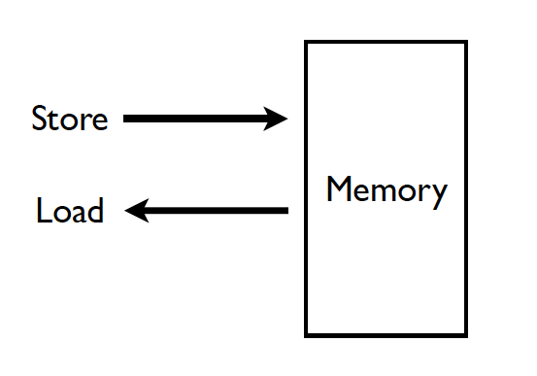
Memory (Programmer’s View)

Slide 3
Ideal Memory
Zero access time (latency)
Infinite capacity
Zero cost
Infinite bandwidth (to support multiple accesses in parallel)

Slide 4
Abstraction: Virtual vs. Physical Memory
Programmer sees virtual memory
Can assume the memory is “infinite”
Reality: Physical memory size is much smaller than what the programmer assumes
The system (system software + hardware, cooperatively) maps virtual memory addresses are to physical memory
The system automatically manages the physical memory space transparently to the programmer
+ Programmer does not need to know the physical size of memory nor manage it → A small physical memory can appear as a huge one to the programmer → Life is easier for the programmer
-- More complex system software and architecture
A classic example of the programmer/(micro)architect tradeoff

Slide 5
Benefits of Automatic Management of Memory
Programmer does not deal with physical addresses
Each process has its own mapping from virtual→physical addresses
Enables
Code and data to be located anywhere in physical memory
(relocation)
Isolation/separation of code and data of different processes in physical processes
(protection and isolation)
Code and data sharing between multiple processes
(sharing)

Slide 6
A System with Physical Memory Only
Examples:
most Cray machines
early PCs
nearly all embedded systems
CPU’s load or store addresses used
directly to access memory
Memory
0:
Physical
Addresses
1:
CPU
N-1:
6

Slide 7
The Problem
Physical memory is of limited size (cost)
What if you need more?
Should the programmer be concerned about the size of code/data blocks fitting physical memory?
Should the programmer manage data movement from disk to physical memory?
Should the programmer ensure two processes do not use the same physical memory?
Also, ISA can have an address space greater than the physical memory size
E.g., a 64-bit address space with byte addressability
What if you do not have enough physical memory?

Slide 8
Difficulties of Direct Physical Addressing
Programmer needs to manage physical memory space
Inconvenient & hard
Harder when you have multiple processes
Difficult to support code and data relocation
Difficult to support multiple processes
Protection and isolation between multiple processes
Sharing of physical memory space
Difficult to support data/code sharing across processes

Slide 9
Virtual Memory
Idea: Give the programmer the illusion of a large address space while having a small physical memory
So that the programmer does not worry about managing physical memory
Programmer can assume he/she has “infinite” amount of physical memory
Hardware and software cooperatively and automatically manage the physical memory space to provide the illusion
Illusion is maintained for each independent process

Slide 10
Basic Mechanism
Indirection (in addressing)
Address generated by each instruction in a program is a “virtual address”
i.e., it is not the physical address used to address main memory
called “linear address” in x86
An “address translation” mechanism maps this address to a “physical address”
called “real address” in x86
Address translation mechanism can be implemented in hardware and software together

Slide 11
A System with Virtual Memory (Page based)
Address Translation: The hardware converts virtual addresses into physical addresses via an OS-managed lookup table (page table)
Memory
0:
Page Table
1:
Virtual
Addresses
Physical
Addresses
0:
1:
CPU
P-1:
N-1:
Disk

Slide 12
Virtual Pages, Physical Frames
Virtual address space divided into pages
Physical address space divided into frames
A virtual page is mapped to
A physical frame, if the page is in physical memory
A location in disk, otherwise
If an accessed virtual page is not in memory, but on disk
Virtual memory system brings the page into a physical frame and adjusts the mapping → this is called demand paging
Page table is the table that stores the mapping of virtual pages to physical frames

Slide 13
Physical Memory as a Cache
In other words…
Physical memory is a cache for pages stored on disk
In fact, it is a fully associative cache in modern systems (a virtual page can be mapped to any physical frame)
Similar caching issues exist as we have covered earlier:
Placement: where and how to place/find a page in cache?
Replacement: what page to remove to make room in cache?
Granularity of management: large, small, uniform pages?
Write policy: what do we do about writes? Write back?

Slide 14
Supporting Virtual Memory
Virtual memory requires both HW+SW support
Page Table is in memory
Can be cached in special hardware structures called Translation Lookaside Buffers (TLBs)
The hardware component is called the MMU (memory management unit)
Includes Page Table Base Register(s), TLBs, page walkers
It is the job of the software to leverage the MMU to
Populate page tables, decide what to replace in physical memory
Change the Page Table Register on context switch (to use the running thread’s page table)
Handle page faults and ensure correct mapping

Slide 15
Some System Software Jobs for VM
Keeping track of which physical frames are free
Allocating free physical frames to virtual pages
Page replacement policy
When no physical frame is free, what should be swapped out?
Sharing pages between processes
Copy-on-write optimization
Page-flip optimization

Slide 16
Page Fault (“A Miss in Physical Memory”)
If a page is not in physical memory but disk
Page table entry indicates virtual page not in memory
Access to such a page triggers a page fault exception
OS trap handler invoked to move data from disk into memory
Other processes can continue executing
OS has full control over placement
Before fault
After fault
Memory
Memory
Page Table
Virtual
Addresses
Physical
Addresses
Page Table
Virtual
Addresses
Physical
Addresses
CPU
CPU
Disk
Disk

Slide 17
Servicing a Page Fault
(1) Processor signals controller
Read block of length P starting at disk address X and store starting at memory address Y
(2) Read occurs
Direct Memory Access (DMA)
Under control of I/O controller
(3) Controller signals completion
Interrupt processor
OS resumes suspended process
(1) Initiate Block Read
Processor
Reg
(3) Read Done
Cache
Memory-I/O bus
(2) DMA Transfer
I/O
controller
Memory
Disk
Disk

Slide 18
Page Table is Per Process
Each process has its own virtual address space
Full address space for each program
Simplifies memory allocation, sharing, linking and loading.
0
Physical Address
Space (DRAM)
Virtual Address Space for Process 1:
0
Address Translation
VP 1
PP 2
VP 2
...
N-1
(e.g., read/only library code)
PP 7
Virtual Address Space for Process 2:
0
VP 1
VP 2
PP 10
...
N-1
M-1

Slide 19
Address Translation
How to obtain the physical address from a virtual address?
Page size specified by the ISA
VAX: 512 bytes
Today: 4KB, 8KB, 2MB, … (small and large pages mixed together)
Trade-offs? (remember cache lectures)
Page Table contains an entry for each virtual page
Called Page Table Entry (PTE)
What is in a PTE?

Slide 20
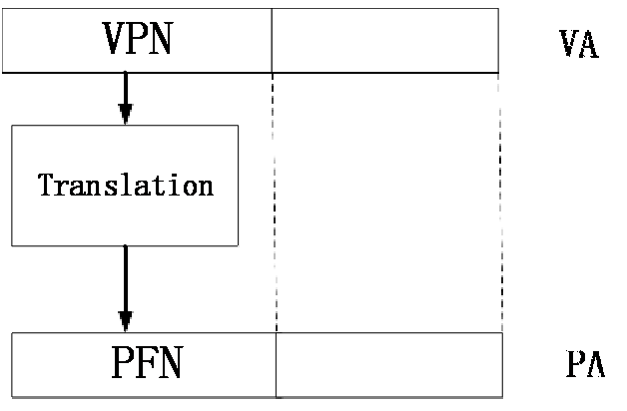
Address Translation (II)
Which Page？
Example: 8K page size
32-bit virtual
address space
VPN->19 bits
->2¹⁹ virtual pages
->2¹⁹ PTEs in page table
(for each process)
Which Byte in Page?
Notes:
2^12 =4096
2^13=8K

Slide 21
Address Translation (III)
Parameters
P = 2^{p} = page size (bytes).
N = 2^{n} = Virtual-address limit
M = 2^{m} = Physical-address limit
n–1
p
p–1
0
virtual page number
page offset
virtual address
address translation
m–1
p
p–1
0
physical frame number
page offset
physical address
Page offset bits don’t change as a result of translation

Slide 22
Address Translation (IV)
Separate (set of) page table(s) per process
VPN forms index into page table (points to a page table entry)
Page Table Entry (PTE) provides information about page
page table
base register
(per process)
virtual address
0
n–1
p
p–1
virtual page number (VPN)
page offset
valid
access
physical frame number (PFN)
VPN acts as
table index
if valid=0
then page
not in memory (page fault)
m–1
p
p–1
0
physical frame number (PFN)
page offset
physical address
22

Slide 23
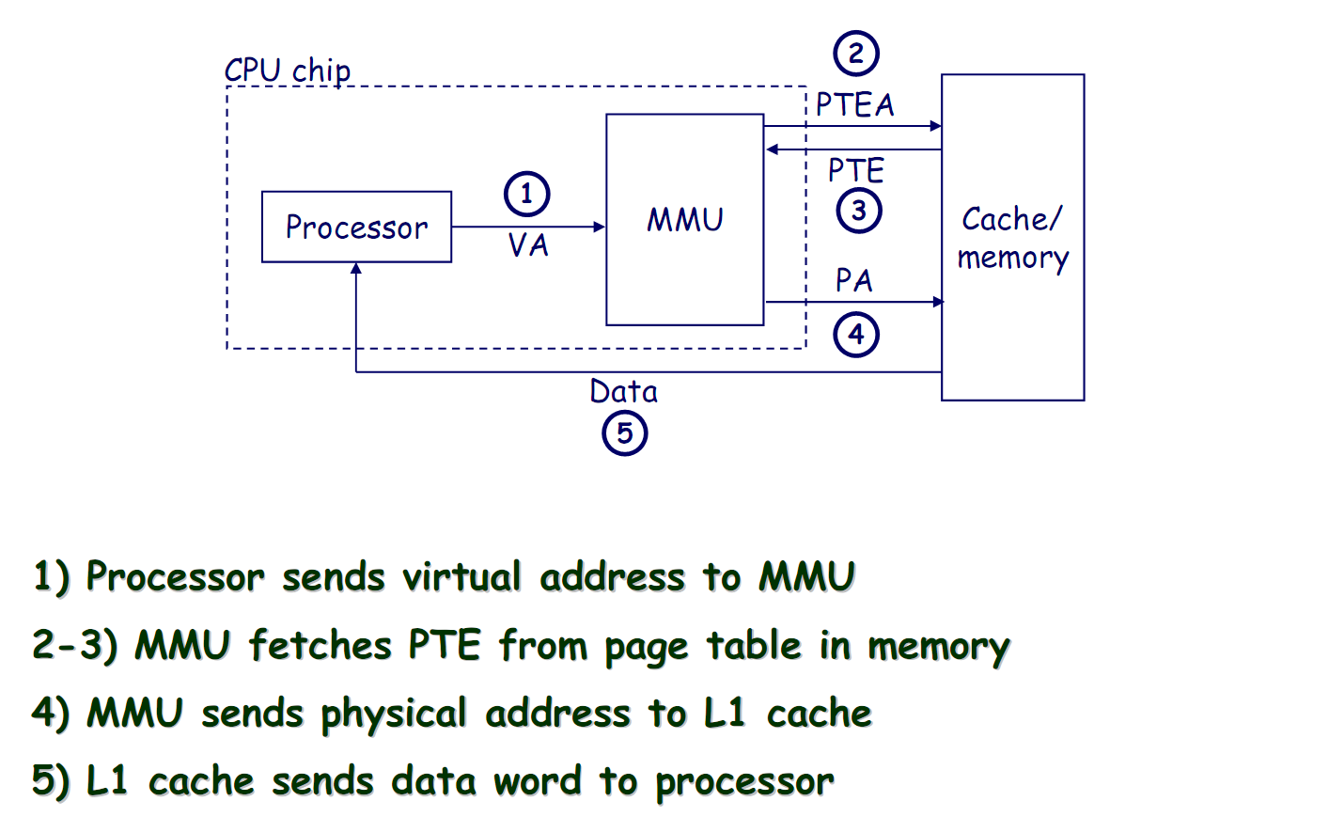
Address Translation: Page Hit

Slide 24
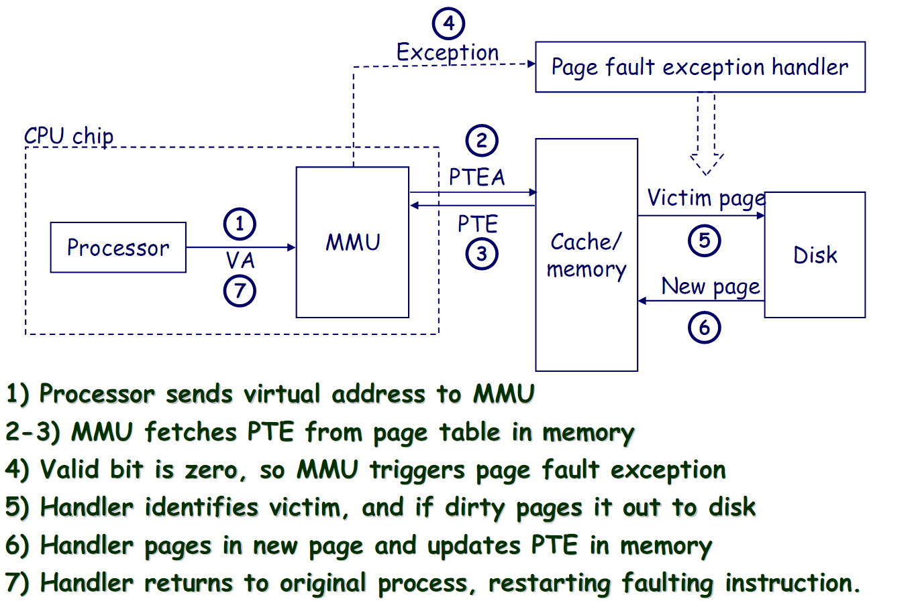
Address Translation: Page Fault

Slide 25

What Is in a Page Table Entry (PTE)?
Page table is the “tag store” for the physical memory data store
A mapping table between virtual memory and physical memory
PTE is the “tag store entry” for a virtual page in memory
Need a valid bit → to indicate validity/presence in physical memory
Need tag bits (PFN) → to support translation
Need bits to support replacement
Need a dirty bit to support “write back caching”
Need protection bits to enable access control and protection
The physical frame the page is stored in (if valid)
PTE
Protection or access control bits
Reference or access bit
25

Slide 26
Remember: Cache versus Page Replacement
Physical memory (DRAM) is a cache for disk
Usually managed by system software via the virtual memory subsystem
Page replacement is similar to cache replacement
Page table is the “tag store” for physical memory data store
What is the difference?
Required speed of access to cache vs. physical memory
Number of blocks in a cache vs. physical memory
“Tolerable” amount of time to find a replacement candidate (disk versus memory access latency)
Role of hardware versus software

Slide 27
Page Replacement Algorithms
If physical memory is full (i.e., list of free physical pages is empty), which physical frame to replace on a page fault?
Is True LRU feasible?
4GB memory, 4KB pages, how many possibilities of ordering?
Modern systems use approximations of LRU
E.g., the CLOCK algorithm
And, more sophisticated algorithms to take into account “frequency” of use
E.g., the ARC algorithm
Megiddo and Modha, “ARC: A Self-Tuning, Low Overhead Replacement Cache,” FAST 2003.

Slide 28
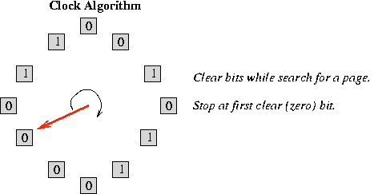
CLOCK Page Replacement Algorithm
Keep a circular list of physical frames in memory
Keep a pointer (hand) to the last-examined frame in the list
When a page is accessed, set the R bit in the PTE
When a frame needs to be replaced, replace the first frame that has the reference (R) bit not set, traversing the circular list starting from the pointer (hand) clockwise
During traversal, clear the R bits of examined frames
Set the hand pointer to the next frame in the list
28

Slide 29
Aside: Page Size Trade Offs
What is the granularity of management of physical memory?
Large vs. small pages
Tradeoffs have analogies to large vs. small cache blocks
Many different tradeoffs with advantages and disadvantages
Size of the Page Table (tag store)
Reach of the Translation Lookaside Buffer (we will see this later)
Transfer size from disk to memory (waste of bandwidth?)
Waste of space within a page (internal fragmentation)
Waste of space within the entire physical memory (external fragmentation)
Granularity of access protection
…

Slide 30
Page-Level Access Control (Protection)
Not every process is allowed to access every page
E.g., may need supervisor level privilege to access system pages
Idea: Store access control information on a page basis in the process’s page table
Enforce access control at the same time as translation
→ Virtual memory system serves two functions today
Address translation (for illusion of large physical memory)
Access control (protection)

Slide 31

Two Functions of Virtual Memory
Virtual Memory
Two functions today
Translation
Access Control (protection)
PTE contains access control bits associated with the virtual page

Slide 32
VM as a Tool for Memory Access Protection
Extend Page Table Entries (PTEs) with permission bits
Check bits on each access and during a page fault
If violated, generate exception (Access Protection exception)
Page Tables
Memory
Read?
Write?
Physical Addr
PP 0
VP 0:
Yes
No
PP 6
Process i:
PP 2
VP 1:
Yes
Yes
PP 4
VP 2:
No
No
XXXXXXX
PP 4
•
•
•
•
•
•
•
•
•
PP 6
Read?
Write?
Physical Addr
PP 8
VP 0:
Yes
Yes
PP 6
PP 10
Process j:
VP 1:
Yes
No
PP 9
PP 12
VP 2:
No
No
XXXXXXX
•
•
•
•
•
•
•
•
•
•
•
•

Slide 33
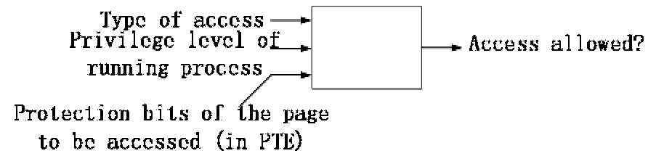
Access Control Logic
Type of access: R, W, E,…
Privilege level: specified by ISA
VAX: Kernel (K), Executive (E), Supervisor (S),
User (U)
Protection bits: Specify what type of access can be made to this page & at what privilege level.

Slide 34
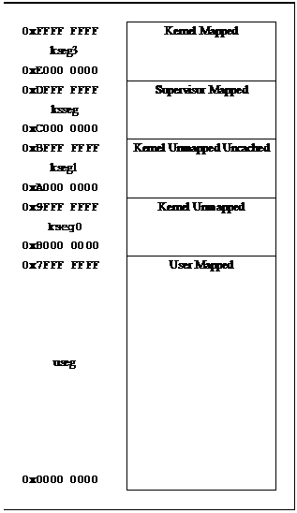
Virtual Address Space in MIPS
MIPS32/microMIPS32 virtual address space is divided into five segments
Kernel
Supervisor
Kernel Unmapped Uncached
Kernel Unmapped
User

Slide 35
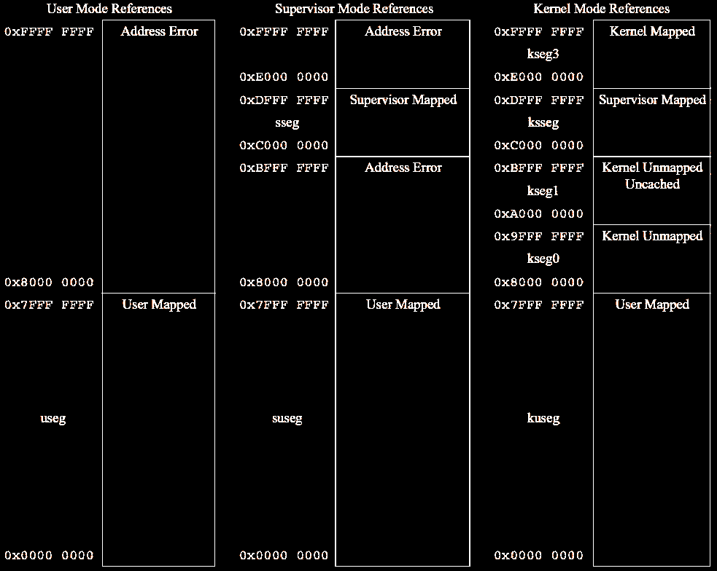
References as a Function of Operating Mode
A MIPS32/microMIPS32 compliant processor must implement
useg/kuseg
kseg0
kseg1

Slide 36
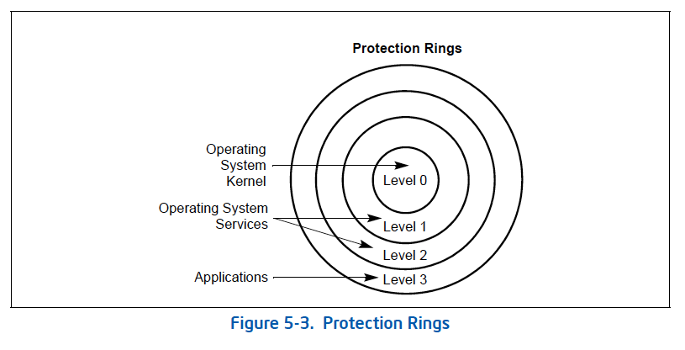
Privilege Levels in x86

Slide 37
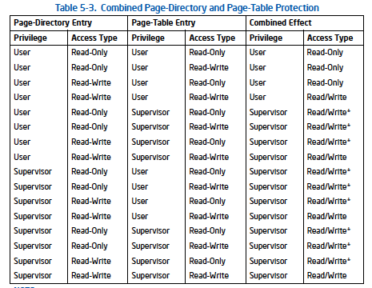
Page Level Protection in x86

Slide 38
Three Major Issues
How large is the page table and how do we store and access it?
How can we speed up translation & access control check?
When do we do the translation in relation to cache access?
There are many other issues we will not cover in detail
What happens on a context switch?
How can you handle multiple page sizes?
…

Slide 39
Virtual Memory Issue I
How large is the page table?
Where do we store it?
In hardware?
In physical memory? (Where is the PTBR?)
In virtual memory? (Where is the PTBR?)
How can we store it efficiently without requiring physical memory that can store all page tables?
Idea: multi-level page tables
Only the first-level page table has to be in physical memory
Remaining levels are in virtual memory (but get cached in physical memory when accessed)
Notes:
PTBR: Page Table Base Register

Slide 40
Issue: Page Table Size
64-bit
Suppose 64-bit VA and 40-bit PA, how large is the page table? 2⁵² entries x ~4 bytes ≈ 16x10¹⁵ Bytes
and that is for just one process!
and the process many not be using the entire VM space!
VPN
PO
52-bit
12-bit
page
table
concat
PA
28-bit
40-bit

Slide 41
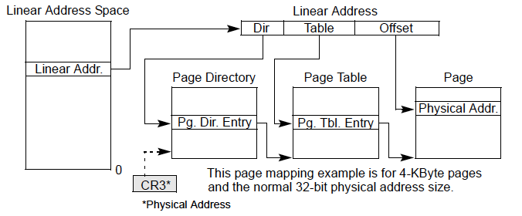
Solution: Multi-Level Page Tables
Example from x86 architecture

Slide 42
Page Table Access
How do we access the Page Table?
Page Table Base Register (CR3 in x86)
Page Table Limit Register
If VPN is out of the bounds (exceeds PTLR) then the process did not allocate the virtual page → access control exception
Page Table Base Register is part of a process’s context
Just like PC, status registers, general purpose registers
Needs to be loaded when the process is context-switched in

Slide 43
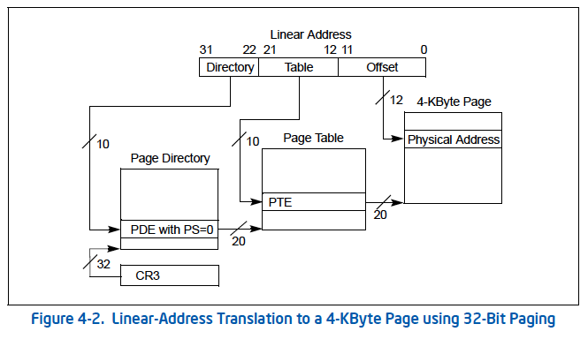
More on x86 Page Tables (I): Small Pages

Slide 44
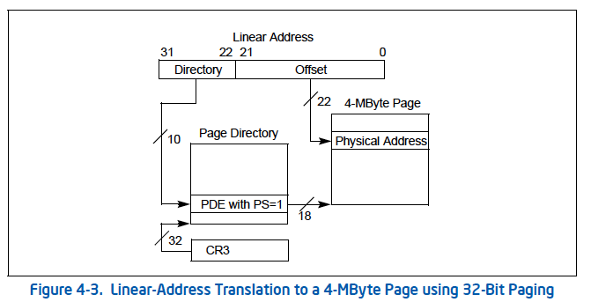
More on x86 Page Tables (II): Large Pages

Slide 45
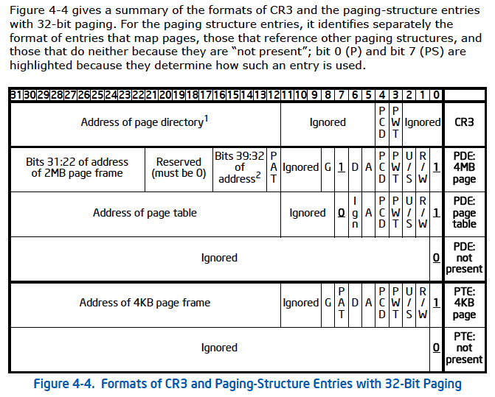
x86 Page Table Entries

Slide 46
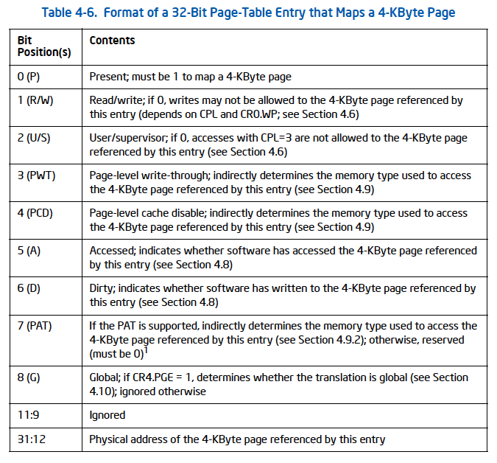
x86 PTE (4KB page)

Slide 47
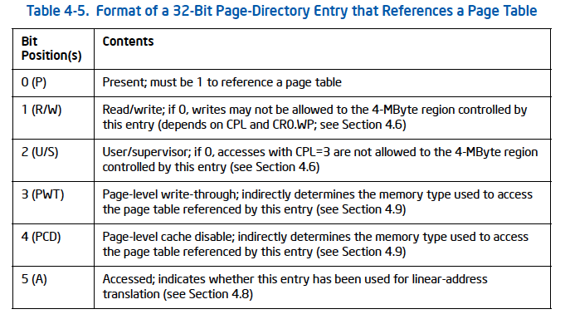
x86 Page Directory Entry (PDE)

Slide 48
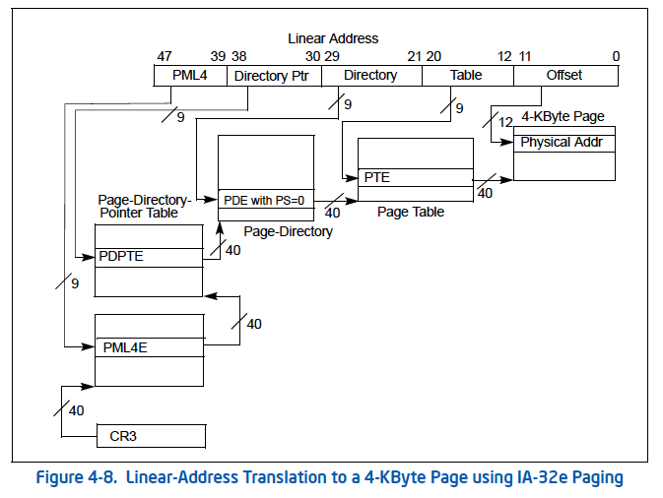
Four-level Paging in x86
Notes:
32-bit Linux

Slide 49
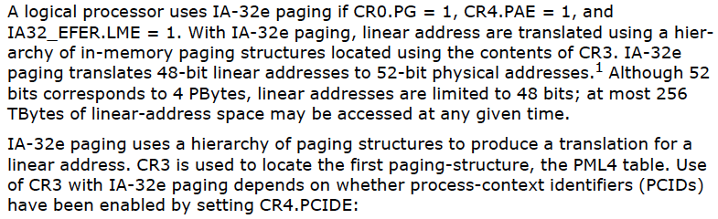
Four-level Paging and Extended Physical Address Space in x86

Slide 50
Virtual Memory Issue II
How fast is the address translation?
How can we make it fast?
Idea: Use a hardware structure that caches PTEs → Translation lookaside buffer
What should be done on a TLB miss?
What TLB entry to replace?
Who handles the TLB miss? HW vs. SW?
What should be done on a page fault?
What virtual page to replace from physical memory?
Who handles the page fault? HW vs. SW?

Slide 51
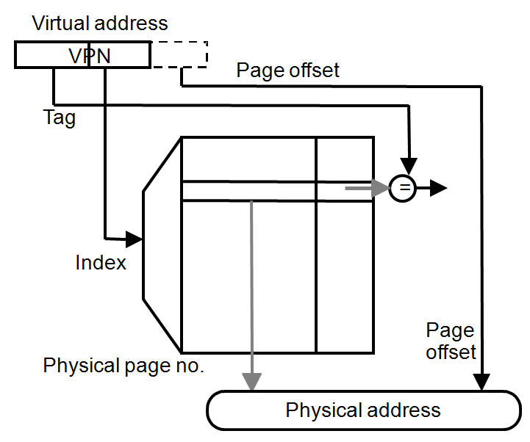
Speeding up Translation with a TLB
Essentially a cache of recent address translations
Avoids going to the page table on every reference
Index = lower bits of VPN
(virtual page #)
Tag = unused bits of VPN +
process ID
Data = a page-table entry
Status = valid, dirty
The usual cache design choices
(placement, replacement policy,
multi-level, etc.) apply here too.

Slide 52
Handling TLB Misses
The TLB is small; it cannot hold all PTEs
Some translations will inevitably miss in the TLB
Must access memory to find the appropriate PTE
Called walking the page directory/table
Large performance penalty
Who handles TLB misses? Hardware or software?

Slide 53
Handling TLB Misses (II)
Approach #1. Hardware-Managed (e.g., x86)
The hardware does the page walk
The hardware fetches the PTE and inserts it into the TLB
If the TLB is full, the entry replaces another entry
Done transparently to system software
Approach #2. Software-Managed (e.g., MIPS)
The hardware raises an exception
The operating system does the page walk
The operating system fetches the PTE
The operating system inserts/evicts entries in the TLB

Slide 54
Handling TLB Misses (III)
Hardware-Managed TLB
Pro: No exception on TLB miss. Instruction just stalls
Pro: Independent instructions may continue
Pro: No extra instructions/data brought into caches.
Con: Page directory/table organization is etched into the system: OS has little flexibility in deciding these
Software-Managed TLB
Pro: The OS can define page table oganization
Pro: More sophisticated TLB replacement policies are possible
Con: Need to generate an exception → performance overhead due to pipeline flush, exception handler execution, extra instructions brought to caches

Slide 55
Virtual Memory Issue III
When do we do the address translation?
Before or after accessing the L1 cache?

Slide 56
Address Translation and Caching
When do we do the address translation?
Before or after accessing the L1 cache?
In other words, is the cache virtually addressed or physically addressed?
Virtual versus physical cache
What are the issues with a virtually addressed cache?
Synonym problem:
Two different virtual addresses can map to the same physical address → same physical address can be present in multiple locations in the cache → can lead to inconsistency in data

Slide 57
Homonyms and Synonyms
Homonym: Same VA can map to two different PAs
Why?
VA is in different processes
Synonym: Different VAs can map to the same PA
Why?
Different pages can share the same physical frame within or across processes
Reasons: shared libraries, shared data, copy-on-write pages within the same process, …
Do homonyms and synonyms create problems when we have a cache?
Is the cache virtually or physically addressed?

Slide 58
Cache-VM Interaction
CPU
CPU
CPU
TLB
VA
cache
PA
cache
tlb
VA
PA
cache
tlb
VA
PA
lower
hier.
lower
hier.
lower
hier.
physical cache
virtual (L1) cache
58
virtual-physical cache

Slide 59
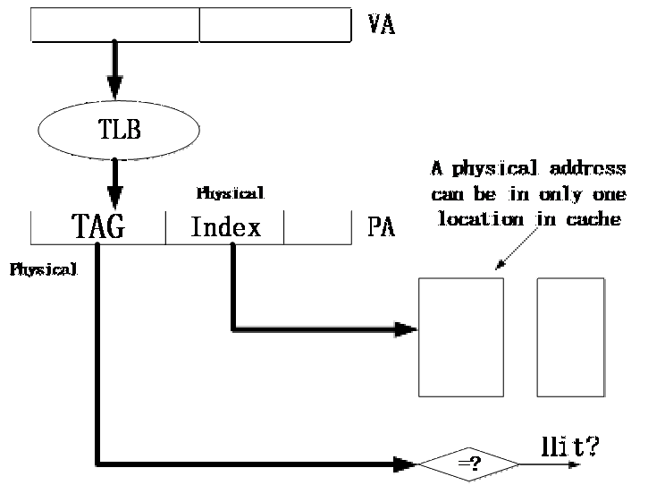
Physical Cache

Slide 60
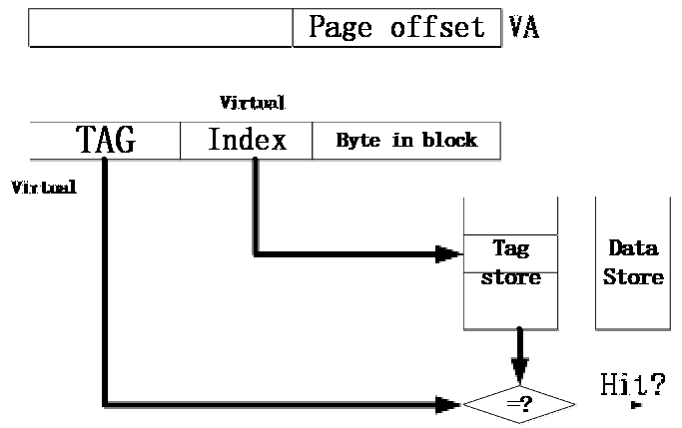
Virtual Cache

Slide 61
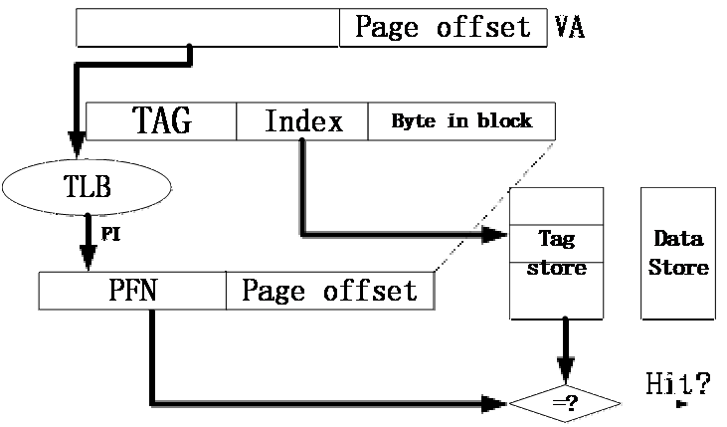
Virtual-Physical Cache
VIPT Cache
Where can the same physical address be in the cache? (???)

Slide 62
Virtually-Indexed Physically-Tagged
If C≤(page_size × associativity), the cache index bits come only from page offset (same in VA and PA)
If both cache and TLB are on chip
index both arrays concurrently using VA bits
check cache tag (physical) against TLB output at the end
VPN
Page Offset
Index
BiB
TLB
physical
cache
PPN
=
tag
data
TLB hit?
cache hit?
62

Slide 63
Virtually-Indexed Physically-Tagged
If C>(page_size × associativity), the cache index bits include VPN ⇒ Synonyms can cause problems
The same physical address can exist in two locations
Solutions?
VPN
Page Offset
Index
BiB
a
TLB
physical
cache
PPN
=
tag
data
TLB hit?
cache hit?
63

Slide 64
Some Solutions to the Synonym Problem
Limit cache size to (page size times associativity)
get index from page offset
On a write to a block, search all possible indices that can contain the same physical block, and update/invalidate
Used in Alpha 21264, MIPS R10K
Restrict page placement in OS
make sure index(VA) = index(PA)
Called page coloring
Used in many SPARC processors

